Slide 1
Lecture No. 27 Flue Gases
At the end of this lecture, students will be able to:
Explain flue gases
Identify the sources of flue gases
Discuss the disadvantages of flue gases
Control measures

Slide 2
Flue Gases
Flue gas : gas that exits to the atmosphere via a flue, which is a pipe or channel for conveying exhaust gases from a fireplace, oven, furnace, boiler or steam generator
Sources: Burning of Fossil fuel to obtain energy, Manufacturing Industries like Paints, Chemicals, Agrochemicals, Leather, etc release flue gases
Pollutants expelled out: oxides of nitrogen, sulphur, carbon, and particulate matter, water vapor

Slide 3
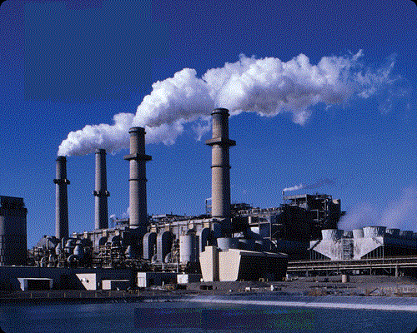
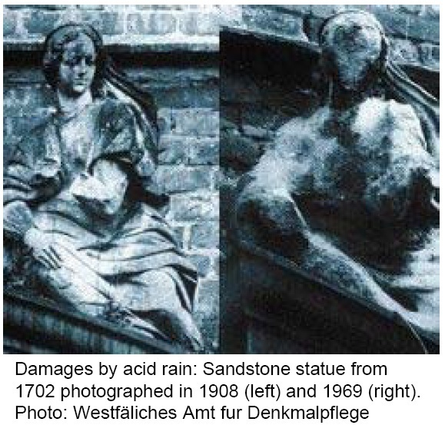
Effect of Flue gas
Emission of SO_{x} one of the major causes of acid precipitation

Slide 4
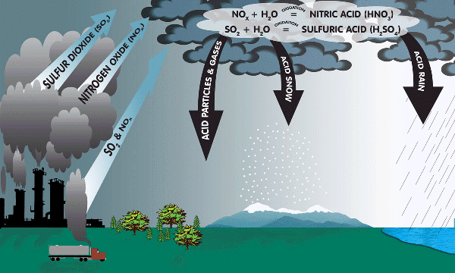
Flue gases effect
Acid rain -emissions of sulfur dioxide & nitrogen oxide, which react with the water molecules in the atmosphere to produce acids
Gases settle in the Boilers, chimneys, other machinery parts
Environmental problems like pollutants entering into food web, global warnings, acid rains, farming issues
Depletion of ozone layer, climatic conditions etc., making a unsafe earth

Slide 5
SO_{X} CONTROL
Fossil fuels such as coal and oil contain a significant amount of sulfur
Fossil fuels when burnt, about 95 % of the sulfur is converted to SO₂
SO₂ + (Excess of O₂) → SO₃
High gas temperature (800 °C) favors formation of SO₃
SO₃ can be formed through catalysis by metals in the fuel
In whatever way SO₃ is formed, it does not behave like SO₂
It forms a liquid aerosol known as sulfuric acid (H₂SO₄) mist, that is very difficult to remove
Sulfuric acid mist is often the cause of the blue haze that often appears as the flue gas plume dissipates. This problem is being addressed by the use of wet electrostatic precipitators

Slide 6
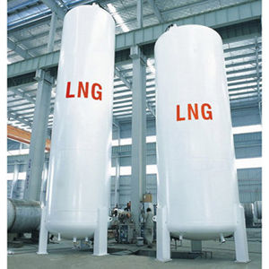
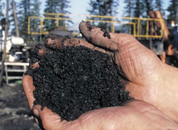
General methods to control SO_{X}
Change to Low Sulfur Fuel
Natural Gas
Liquefied Natural Gas
Low Sulfur Oil
Low Sulfur Coal
Use Desulfurized Coal and Oil Increase Effective Stack Height
Build Tall Stacks
Redistribution of Stack Gas Velocity Profile
Modification of Plume Buoyancy

Slide 7
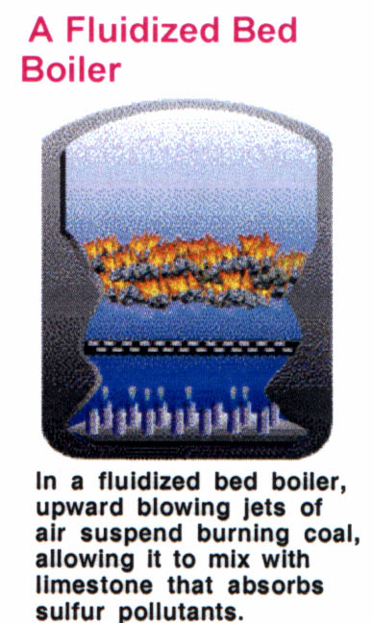
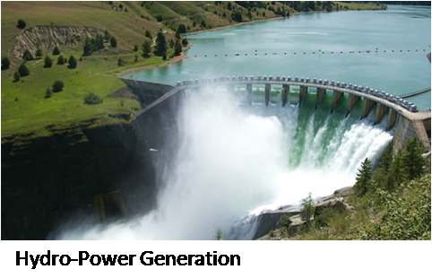
General methods to control SO_{X}
Use Flue Gas Desulfurization Systems
Use Alternative Energy Sources,
such as Hydro-Power or Nuclear-Power

Slide 8
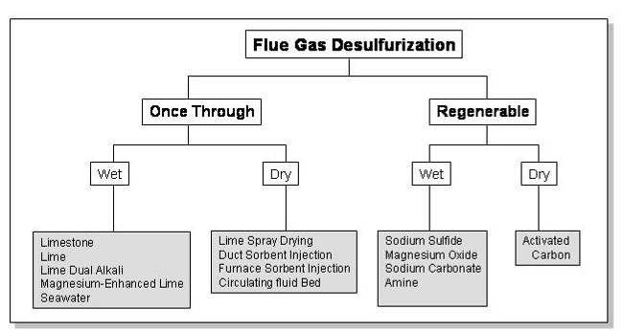
Flue Gas Desulfurization
SO₂ scrubbing, or Flue Gas Desulfurization processes can be classified as:
Throwaway or Regenerative, depending upon whether the recovered sulfur is discarded or recycled
Wet or Dry, depending upon whether the scrubber is a liquid or a solid

Slide 9
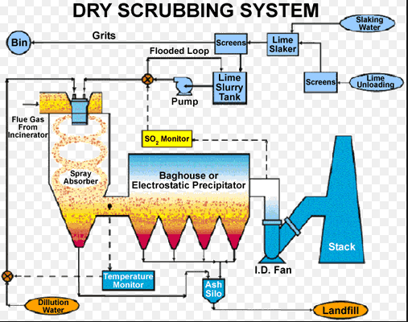
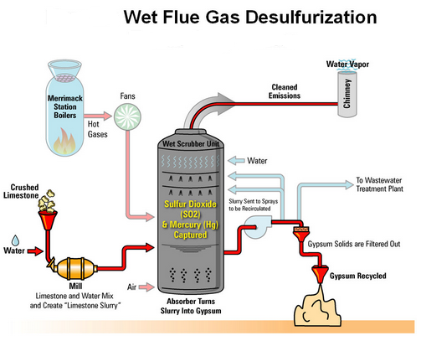
Dry scrubbing and wet scrubbing system

Slide 10
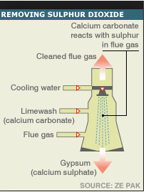
Flue Gas Desulfurization
Flue Gas Desulfurization Processes
The major flue gas desulfurization ( FGD ), processes are :
Limestone Scrubbing
Lime Scrubbing
Dual Alkali Processes
Lime Spray Drying
Wellman-Lord Process
Flue Gas Desulfurization process at Great Plains Synfuels Pl

Slide 11
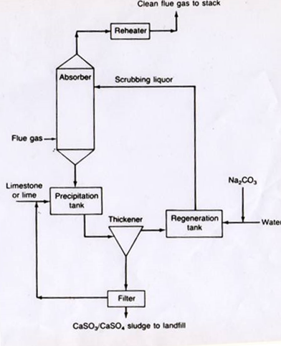
Limestone Scrubbing
Limestone slurry is sprayed on the incoming flue gas
Sulfur dioxide gets absorbed
CaCO₃ + H₂O + 2SO₂ ----> Ca⁺² + 2HSO₃⁻+ CO₂
CaCO₃ + 2HSO₃⁻+ Ca⁺² ----> 2CaSO₃ ₊ CO₂ + H₂O

Slide 12
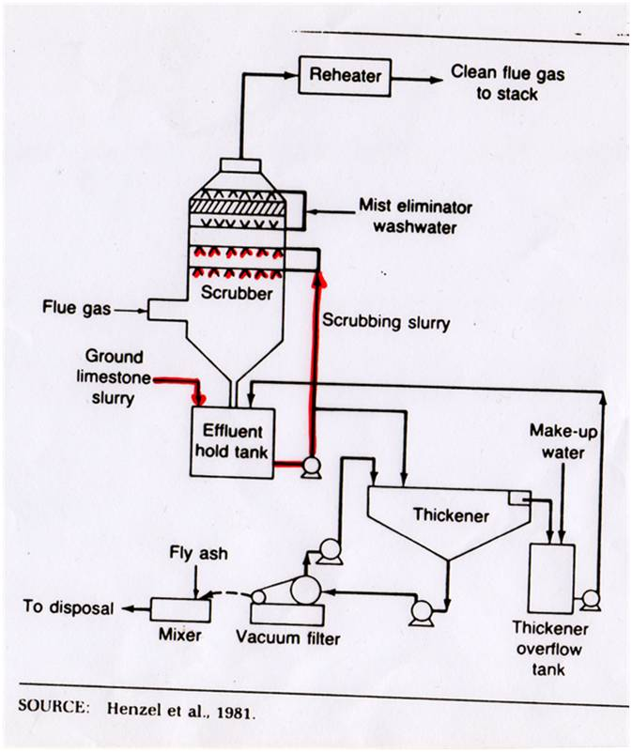
Lime Scrubbing
Lime Scrubbing offers better utilization of the reagent
Operation is more flexible
CaO + H₂O -----> Ca(OH)₂
SO₂ + H₂O <----> H₂SO₃
H₂SO₃ ₊ Ca(OH)₂ -----> CaSO₃.2 H₂O
CaSO₃.2 H₂O + (1/2)O₂ -----> CaSO₄.2 H₂O

Slide 13
Disadvantages of lime and lime stone scrubbing system
Major disadvantage is the high cost of lime compared to limestone
Lime and Limestone scrubbing lead to deposits inside spray tower.
Deposits can lead to plugging of the nozzles through which the scrubbing slurry is sprayed

Slide 14
Dual Alkali System
Dual Alkali system uses two regents to remove the sulfur dioxide
Sodium sulfite / Sodium hydroxide are used for the absorption of sulfur dioxide inside the spray chamber
Resulting sodium salts are soluble in water, so no deposits are formed
Water spray is treated with lime or limestone, along with make-up sodium hydroxide or sodium carbonate
Sulfite / sulfate ions are precipitated, and the sodium hydroxide is regenerated

Slide 15
Lime – Spray Drying
Lime Slurry is sprayed into the chamber
Sulfur dioxide is absorbed by the slurry
Liquid-to-gas ratio is maintained such that the spray dries before it reaches the bottom of the chamber
Dry solids are carried out with the gas, and are collected in fabric filtration unit
System needs lower maintenance, lower capital costs, and lower energy usage

Slide 16
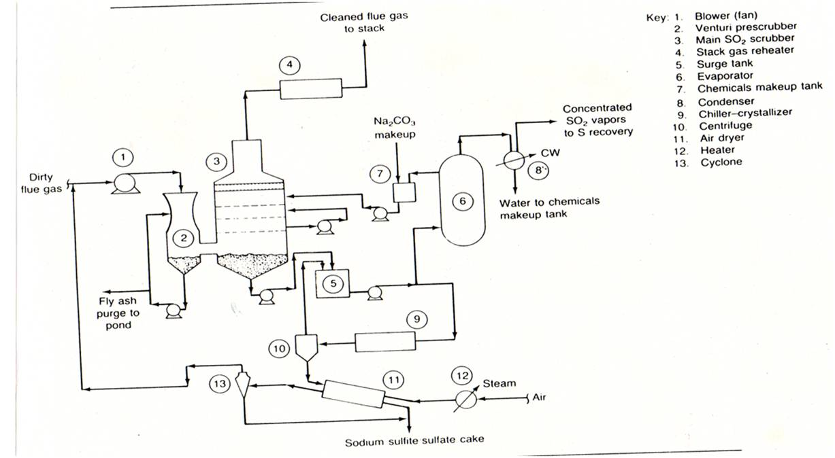
Wellman – Lord Process
Schematic process flow diagram – SO₂ scrubbing and recovery system

Slide 17
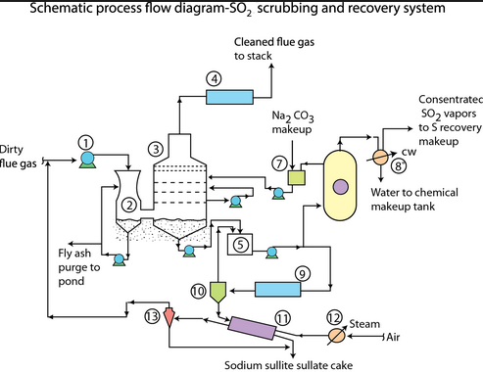
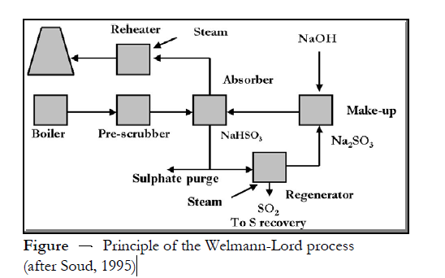
Wellman – Lord Process

Slide 18
Wellman – Lord Process…
In this process, sulfur dioxide from flue gas is absorbed in a sodium sulfite solution in water forming sodium bisulfite; other components of flue gas are not absorbed
After lowering the temperature the bisulfite is converted to the sodium persulfite which precipitates
Notes:
Na2O8S2 sodium perosulfite

Slide 19
Wellman – Lord Process
Process consists of the following sub processes:
Flue gas pre-treatment
Sulfur dioxide absorption by sodium sulfite
Purge treatment
Sodium sulfite regeneration
The concentrated sulfur dioxide stream is processed to a marketable product.
Flue gas is pre - treated to remove the particulate. The sodium sulfite neutralizes the sulfur dioxide :
Na₂SO₃ + SO₂ + H₂O -----> 2NaHSO₃
Sodium sulphite sodium bisulphite
Notes:
Sodium sulfite is a soluble sodium salt of sulfurous acid with the chemical formula Na₂SO₃. It is a product of sulfur dioxide scrubbing, a part of the flue-gas desulfurization process

Slide 20
Wellman – Lord Process
Some of the Na₂SO₃ reacts with O₂ and the SO₃ present in the flue gas to form Na₂SO₄ and NaHSO₃
Sodium sulfate does not help in the removal of sulfur dioxide, and is removed
Part of the bisulfate stream is chilled to precipitate the remaining bisulfate and remaining bisulfate stream is evaporated to release the sulfur dioxide, and regenerate the bisulfite

Slide 21
NO_{X} CONTROL Background on Nitrogen Oxides
NO nitric oxide
NO₂ nitrogen-di-oxide
NO₃ nitrate
N₂O dinitrogen monoxide
N₂O₃ dinitrogen trioxide
N₂O₄ dinitrogen tetraoxide
N₂O₅ dinitrogen pentaoxide
NO and NO₂ are the most common of the seven oxides listed above NOx released from stationary sources is of two types

Slide 22
General Methods For Control of NOx Emissions
NOx control can be achieved by:
Fuel Denitrogenation
Combustion Modification
Modification of operating conditions
Tail-end control equipment
Selective Catalytic Reduction
Selective Non - Catalytic Reduction
Electron Beam Radiation
Staged Combustion

Slide 23
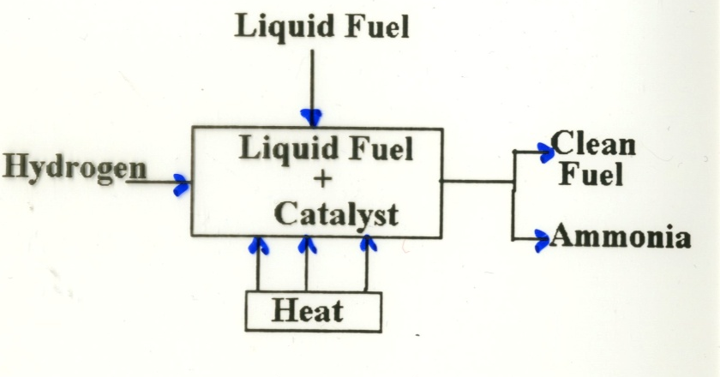
Fuel Denitrogenation
One approach of fuel denitrogenation is to remove a large part of the nitrogen contained in the fuels
Nitrogen is removed from liquid fuels by mixing the fuels with hydrogen gas, heating the mixture and using a catalyst to cause nitrogen in the fuel and gaseous hydrogen to unite. This produces ammonia and cleaner fuel
Reduce the nitrogen contained in both
naturally occurring and synthetic fuels

Slide 24
Combustion Modification
Combustion control uses one of the following strategies:
Reduce peak temperatures of the flame zone. The methods are :
increase the rate of flame cooling
decrease the adiabatic flame temperature by dilution
Reduce residence time in the flame zone. For this we change the shape of the flame zone
Reduce Oxygen concentration in the flame one. This can be accomplished by:
decreasing the excess air
controlled mixing of fuel and air
using a fuel rich primary flame zone

Slide 25
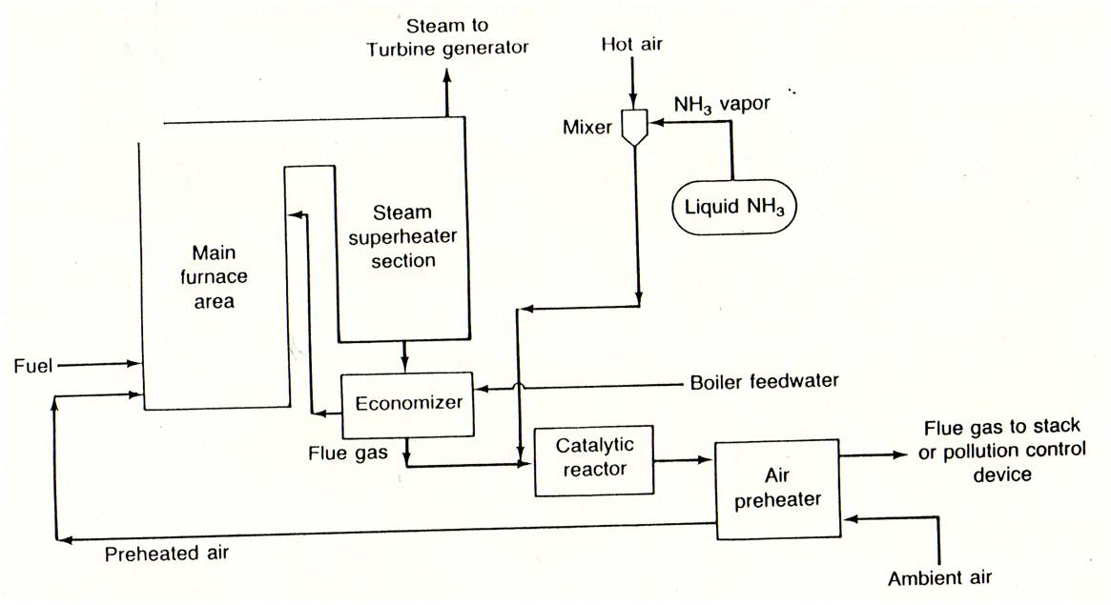
Selective Catalytic Reduction (SCR)
Schematic process flow diagram – NO_{X} control

Slide 26
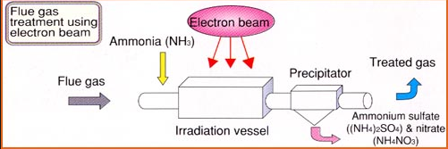
Electron Beam Radiation
This treatment process is under development, and is not widely used
Irradiation of flue gases containing NOx or SOx produce nitrate and sulfate ions
The addition of water and ammonia produces NH₄NO₃, and (NH₄)₂SO₄
The solids are removed from the gas, and are sold as fertilizers

Slide 27
Formation of Carbon Monoxide
Carbon Monoxide Control
Due to insufficient oxygen
Factors affecting Carbon monoxide formation:
Fuel-air ratio
Degree of mixing
Temperature

Slide 28
Sources of Carbon Dioxide
Human-Related Sources
Combustion of fossil fuels: Coal, Oil, and Natural Gas in power plants, automobiles, and industrial facilities
Use of petroleum-based products
Industrial processes: Iron and steel production, cement, lime, and aluminum manufactures
Natural Sources
Volcanic eruptions
Ocean-atmosphere exchange
Plant photosynthesis

Slide 29
General methods for control of CO emissions
Stationary Sources
Proper Design
Installation
Operation
Maintenance
Process Industries
Burn in furnaces or waste heat boilers

Slide 30
General methods for control of CO₂ emissions
Reducing energy consumption, increasing the efficiency of energy conversion
Switching to less carbon intensive fuels
Increasing the use of renewable sources
Sequestering CO₂ through biological, chemical, or physical processes

Slide 31
Industrial Sources of Particulate Emissions
Particulate Matter Control
Iron & Steel Mills, the blast furnaces, steel making furnaces
Petroleum Refineries, the catalyst regenerators, air-blown asphalt stills, and sludge burners
Portland cement industry, Asphalt batching plants
Production of sulfuric acid, Production of phosphoric acid
Soap and Synthetic detergent manufacturing
Glass & glass fiber industry
Nuclear power stations

Slide 32
Effects of particulate emissions
Primary Effects
Reduction of visibility
size distribution and refractive index of the particles
direct absorption of light by particles
direct light scattering by particles
limit - 150 μg / m³ concentration ~ average visibility of 5 miles
( satisfactory for air and ground transportation )
threshold limit is 200 - 250 μg / m³ ( dust )
levels of 400 - 500 μg / m³ considered as nuisance

Slide 33
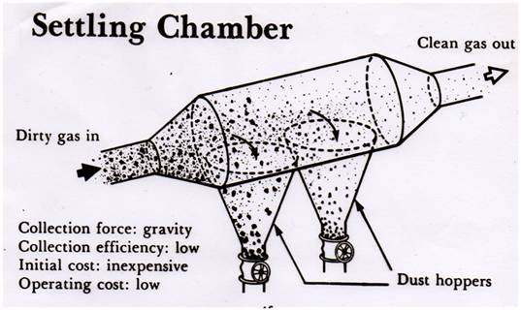
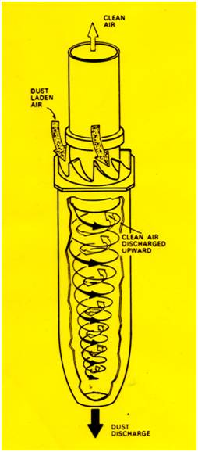
General methods for control of particulate emissions
Five basic types of dust collectors :
Gravity and Momentum collectors
Settling chambers, baffle chambers
Centrifugal Collectors
Cyclones
Mechanical centrifugal collectors
Fabric Filters
Bag houses
Fabric collectors

Slide 34
General methods for control of particulate emissions
Electrostatic Precipitators
Tubular
Plate
Wet
Dry
Wet Collectors
Spray towers
Impingement scrubbers
Wet cyclones
Peaked towers
Mobile bed scrubbers

Slide 35
Summary
Flue gases: Nox, Sox, CO, CO₂
Sources of flue gases: Industries, Domestic, Thermal power plants, autombiles
Measures to control them: Desulphurization, denitrogenation
Control of Particulate matter: Gravity settlers, centrifugal filters, fabric filters

